Slide 1
Leads with balances
Or missing orders

Slide 2
Context
Problem Statement
Fixes
Timing, risks, constraints

Slide 3

Context
Orders can currently be placed via the following methods:
KOKOPoint
myKOKO
Promotor sign up; a feature within myKOKO which allows the user to create an account for potential customer; the lead then sends money to create an order
KOKOfuel.com
KOKO Admin (individual & bulk)
There are a few constraints in these journeys which is leading to a number of customers having a balance, but no order. In addition we have cases where customers directly to our till which creates an account but not an order.
This leads to confusion for the customer (when they hit full balance) and contributes to under reporting of our savings orders. As savings orders have become a KPI for investors it is important that we adjust for leads with balances as soon as possible.

Slide 4
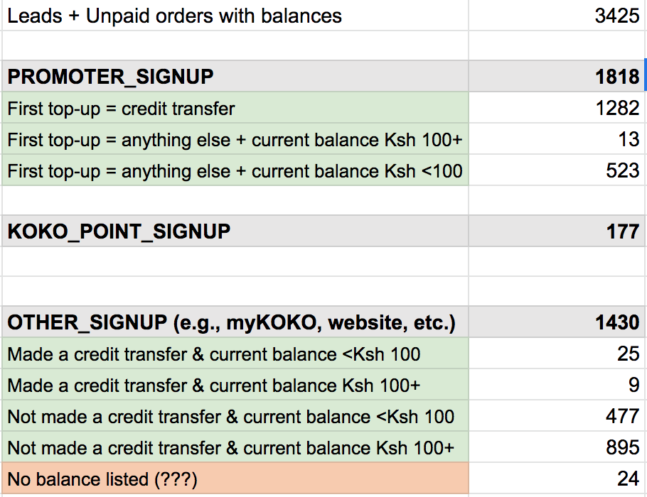
The problem
A large number of customers have a balance in the KOKO wallet but no order. We can split these out based on sign up channel.
For promoter sign up the minimum threshold for an order is Ksh 100. Therefore 536 (523+13) customers were unable to create orders because their first top up was less than Ksh 100.
For KP sign up it is possible for a customer to drop off in the order creation journey which has resulted in 177 missed orders.
The rest of the missed orders come from a combination of myKOKO, kokofuel.com and accounts created because people sent money direct to our MPESA till.

Slide 5
Option 2
Order Creation for all

Slide 6
Extend current order creation functionality
Currently on promoter sign up an order is created automatically when the customer makes their first top up.
Currently the customer is required to send >Ksh100.
There is a rule that says only do this for ‘promoter sign up’
Changes:
Remove rule on ‘promoter sign up only’
Add rule to exclude cooker owners and fuel users.

Slide 7
Clean up of existing orders

Slide 8
Cleaning up orders
To date there have been a number we have a number of leads with balance who don’t have orders. We need to be able to create orders for them.
Solution
> Create a script for the people without orders - would need list of numbers and user ids.

Slide 9
Fixes
Supported changes

Slide 10
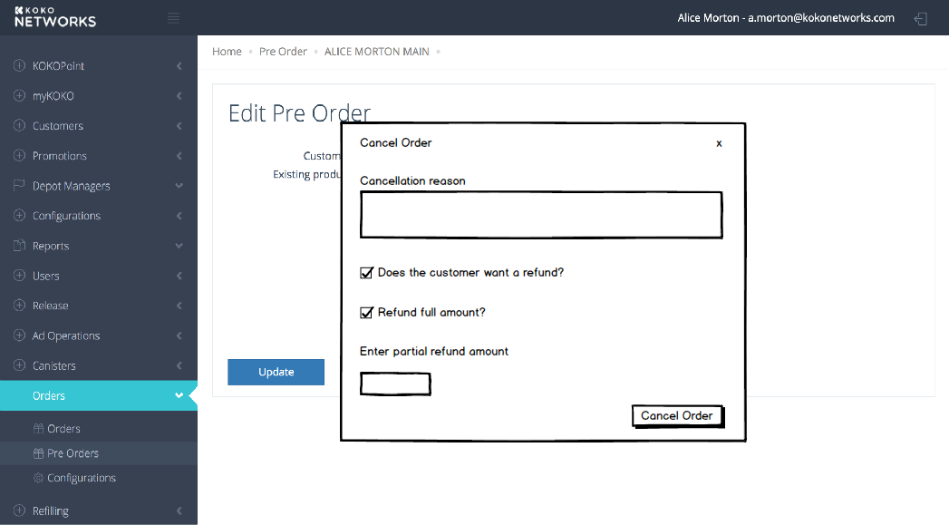
Improve order cancellation for savings order
Customer calls to cancel order
Customer calls to cancel order
Customer Care user looks up savings order
User selects cancel order
User selects if a refund is required
User enters how much to refund
User clicks refund
FIxes:
Update existing cancel pre order screen to allow for an optional refund and for Customer Care to enter the amount.
Remove the cancellation fee altogether.
https://xd.adobe.com/view/809dab17-7cfa-4663-4ef0-cfd33a98c2dc-f6ac/?fullscreen

Slide 11
Ts & Cs acceptance
Customer comes to collect cooker or logs in for first time
View Account
Customer logs in
Has customer accepted Ts and Cs?
Accept Ts and Cs
Buy Cooker
Fulfilment complete
Safety video
User gets free refill
Required changes
Currently our acceptance of Ts and Cs is weak from a legal perspective, particularly for promotor sign ups, which is the platform used by CSRs to drive up orders. We need to make acceptance of Ts and Cs part of the first time journey on the KP as this is the one unique contact for all our customers.
Move Ts and Cs acceptance to first time log-in on myKOKO so that it covers all sign ups not just order.
Log acceptance of Ts and Cs in KOKO Core. This allows us to check if the customer has explicitly accepted Ts and Cs previously and whether or not to show the screen.
Add a check in the buy cooker journey such that if the customer has previously accepted Ts and Cs they are not required to again.
In addition the first time the customer sends us money we should send them a text with a link to the terms and conditions
KP designs for Ts and Cs exist - so front end work is limited to rewiring journeys and receiving / sending information to KOKO Core.

Slide 12
Deployment considerations

Slide 13
Supporting activities
Timelines | Build / Buy | Resources | Deployment Considerations
As soon as possible to provide accurate numbers Look to release in May Suggest prioritising the highest value changes (promoter sign up, KP, no phone numbers) | These are fixes to our existing applications There is no suitable 3rd party solution as accounts and orders should be retained on KOKO Core. | 1 android 2 server side 1 QA engineer Approximately 2 weeks of work. | Release involves KC and KP Customer journey and order creation documentation to be refreshed and updated Training for customer care on new process for cancelling orders
Systems Impact | KPIs | Backwards Compatibility | Risks and Constraints
Small changes but across multiple applications (KP, KOKO Core) | # of customers with a balance and no order | not proposing to create new APIs these changes would not be backwards compatible but can be reversed or modified if required. | Possibility of creating orders for customers who do not have an interest in buying a cooker

Slide 14
Supporting activities
Check with Commercial & Legal if Ts and Cs need updating

Slide 15
Appendix

Slide 16
Option 1
Discounted Option
Order Creation split by platform

Slide 17
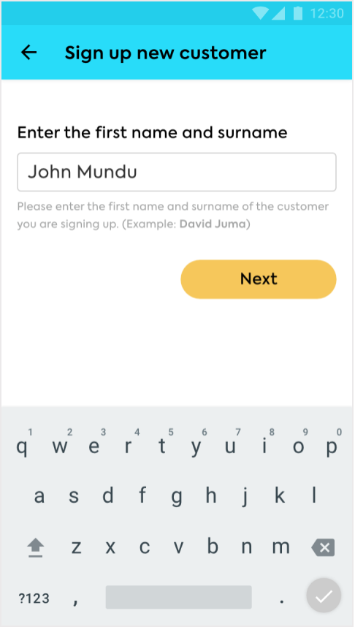
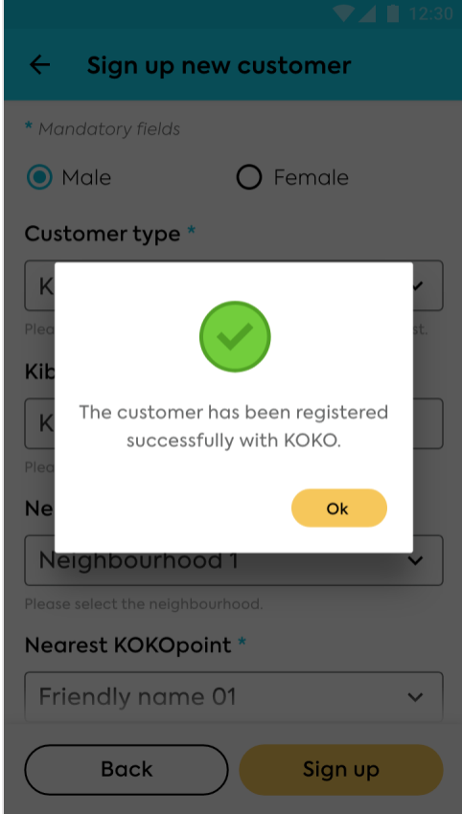
Promoter signup should auto-create orders
Once the customer is signed up they receive a text message telling them to send money. When a top up or credit transfer of >Ksh 100 is received the order is created.
Fix: Change the threshold for order creation to >0

Slide 18
KP signup should auto-create orders
Customer clicks buy cooker
Api call to create account
Customer enters phone number
Customer enters name
Api call to place order
Customer enters OTP
Customer sets pin
Customer views payment instructions
Customer informed their order has been placed
When a customer comes to the KP to buy a cooker they have to set up an account before placing an order. There is potential for them to drop off before the 7th step thereby creating an account but not an order.
Fix: Move the API call for order placement to immediately following the creation of an account (step 3)

Slide 19
Ts & Cs acceptance
Customer comes to collect cooker
Customer logs on
Customer enters serial ID
Accept Ts and Cs
Safety video
User gets free refill
Fulfilment complete
Currently our acceptance of Ts and Cs is weak from a legal perspective, particularly for promotor sign ups, which is the platform used by CSRs to drive up orders. We need to make acceptance of Ts and Cs part of the fulfilment journey as this is the one unique contact for all our customers.
We should also log acceptance of Ts and Cs in KOKO Core.
KP designs for Ts and Cs exist - so front end work is limited to rewiring journeys and receiving / sending information to KOKO Core.

Slide 20
Other signup should auto-create orders
Platform | Today | Suggested fix
KOKOfuel.com | Similar to the KP, orders are created right at the end of the journey so potentially lost if there are any drop offs | Move API call for place order to earlier in the journey once account creation has happened.
myKOKO | The Buying journey is separate from account creation but myKOKO really exists now for commissions and referrals | Suggest no change as target users are not end customers buying their first cooker. myKOKO household customers make up only 114 cases of missed orders.
People sending money to the till | An account is created for the customer at this point and money is stored against that account | When account is created also place an order for the customer at this point. This is the highest priority as makes up 1556 missing orders.
KOKO Admin Bulk Signup | Orders are already created at the point of account creation | No Change
KOKO Admin | Order creation and account creation should remain decoupled. Already very simple to create an order for a customer once the account is set up. | No Change

